Slide 1

Housing Project Submitted by: Harsh Nema

Slide 2
Problem Statement
A US-based housing company named Surprise Housing company is looking at prospective properties to buy houses to enter the Australian market. We are required to build a model using Machine Learning in order to predict the actual value of the prospective properties and decide whether to invest in them or not. The focus is to answer the below questions:
Which variables are important to predict the price of variable?
How do these variables describe the price of the house?

Slide 3
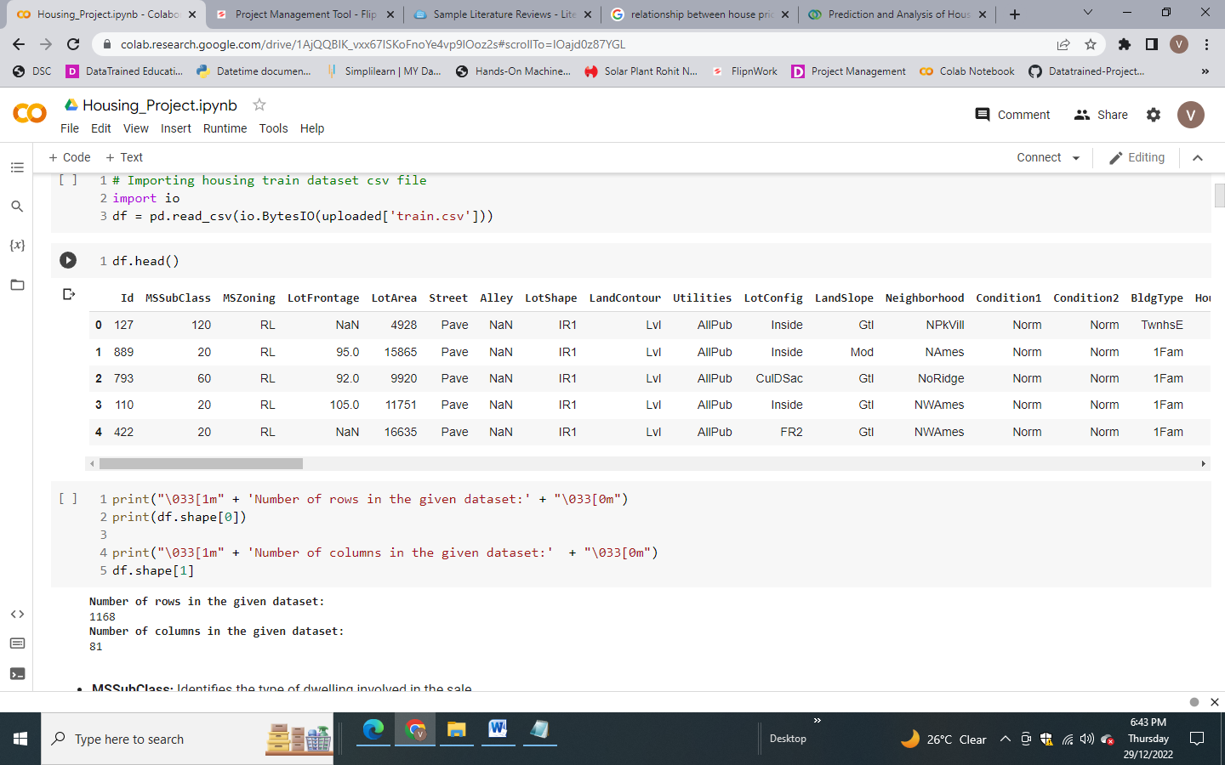
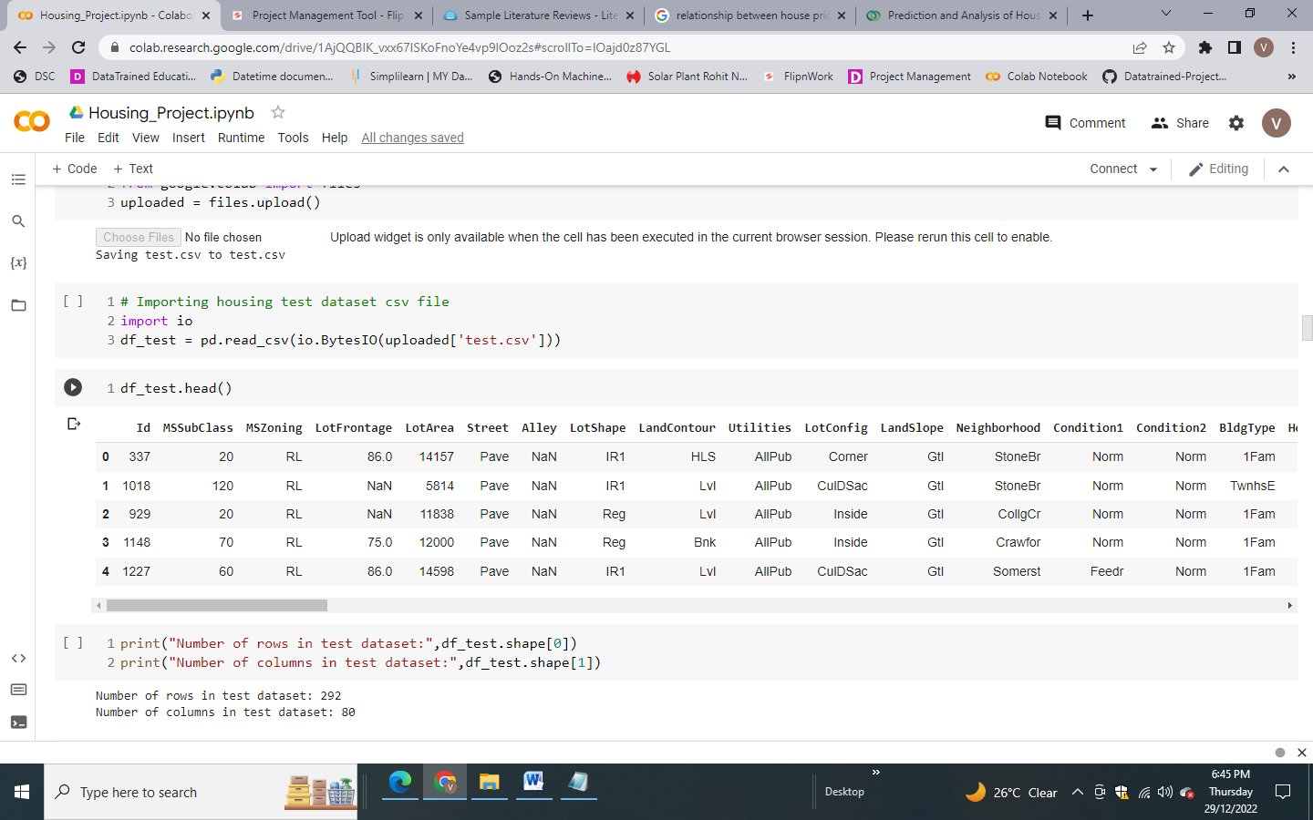
About the dataset
Dataset provided by Flip Robo was in the format of CSV (Comma Separated Values). There are 2 data sets that are given. One is training data and one is testing data.
Train file will be used for training the model, i.e., the model will learn from this file. It contains all the independent variables and the target variable. The dimension of data is 1168 rows and 81 columns.
Test file contains all the independent variables, but not the target variable. We will apply the model to predict the target variable for the test data. The dimension of data is 292 rows and 80 columns
Train data
Test data

Slide 4
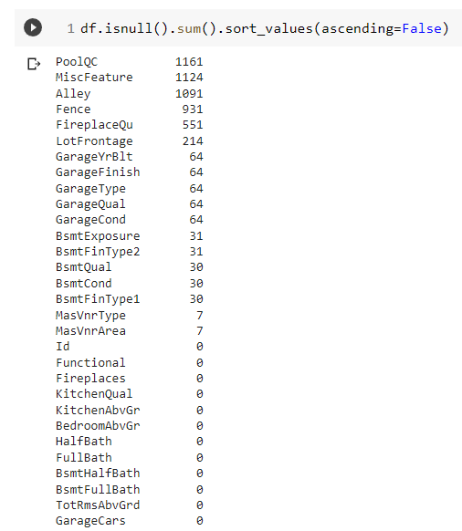

Initial Observations
Lot of missing values in the training dataset, need to do the imputation of missing values
Test dataset has also many null values

Slide 5
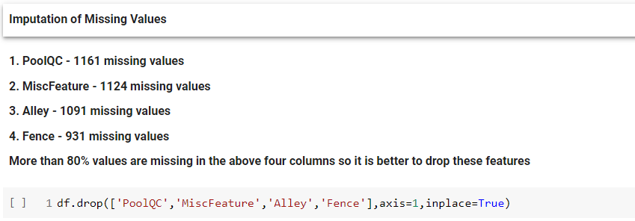
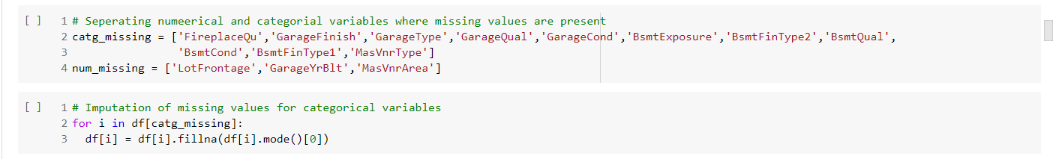
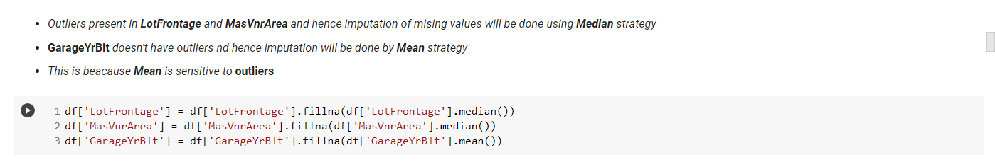
Initial Observations
Dropping the columns having more than 80% null values
Imputation of missing values

Slide 6
Univariate Analysis

Slide 7
Univariate Analysis

Slide 8
Univariate Analysis

Slide 9
Univariate Analysis

Slide 10
Univariate Analysis

Slide 11
Univariate Analysis

Slide 12
Univariate Analysis

Slide 13
Bivariate Analysis

Slide 14
Bivariate Analysis

Slide 15
Bivariate Analysis

Slide 16
Bivariate Analysis

Slide 17
Bivariate Analysis

Slide 18
Bivariate Analysis

Slide 19
Bivariate Analysis

Slide 20
Bivariate Analysis

Slide 21
Multivariate Analysis

Slide 22
Multivariate Analysis

Slide 23
Multivariate Analysis

Slide 24
Conclusion
ML Algorithm | R2 Score |  | CV Score
 | Train | Test
Linear Regression | 77% | 89.30% | 76.23%
K Neighbors Regressor | 82.60% | 86.70% | 75.66%
Random Forest Regressor | 97.06% | 90.35% | 82.25%
Ada Boost Regressor | 84.95% | 84.07% | 75.12%
Support Vector Regressor | 5.09% | 5.18% | -6.06
Extreme Gradient Boost Regressor(XGB) | 94.48% | 91.23% | 82.70%
Hyper Parameter Tuning for XGB | 94.48% | 91.23% | 82.70%

